Slide 1
Hardware / Software
BUS 140: Business Information Technology

Slide 2
Understanding Your Computer: Computers are Data Processing Devices
Perform four major functions
Input: Gather data, enter data
Process: Manipulates, calculates, or organizes data
Output: Displays data and information
Storage: Saves data and information
Notes:
4
Computer is a data processing device that performs four major functions:
1. Input: It gathers data, or allows users to enter data.
2. Process: It manipulates, calculates, or organizes that data into information.
3. Output: It displays data and information in a form suitable for the user.
4. Storage: It saves data and information for later use.

Slide 3
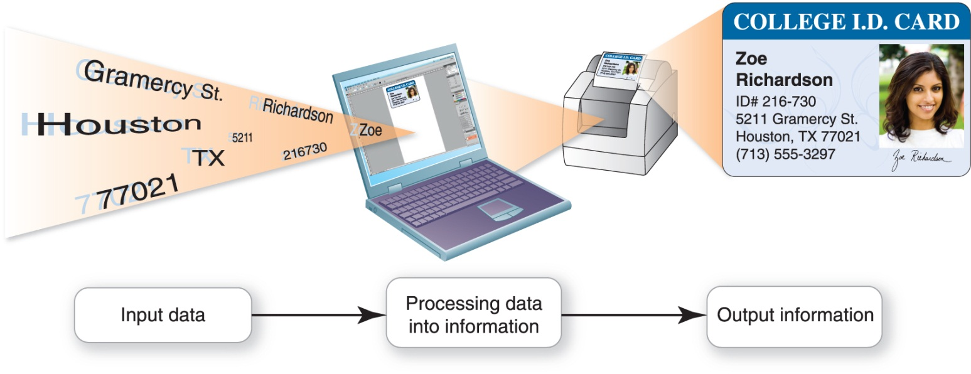
Understanding Your Computer: Computers are Data Processing Devices (cont.)
Data – collection of facts
Information – data turned into useful form
Processing – organizing data into information
Notes:
5
Data is a representation of a fact, figure, or idea.
Data can be a number, a word, a picture, or even a recording of sound.
The number 7135553297 and the names Zoe and Richardson are data.
Information is data that has been organized or presented in a meaningful fashion.
When a contact listing at indicates Zoe Richardson’s phone number is (713) 555-3297, the data becomes useful information.
Processing is manipulating, calculating, or organizing data into information.

Slide 4
Understanding Your Computer: Bits and Bytes: The Language of Computers
Bit – single binary digit (either 0 or 1)
Byte – combination of 8 bits used to represent a letter, number, or symbol
There are 256 (or 2⁸) unique byte patterns e.g., 10110011, 00001010, 01110100
ASCII is a universal encoding/decoding system
Notes:
6
To process data into information, computers need a language they understand. This language, called binary language, consists of just two digits: 0 and 1.
Everything a computer does, such as processing data, printing a report, or editing a photo, is broken down into a series of 0s and 1s.
Each 0 and 1 is a binary digit, or bit for short.
Eight binary digits (or bits) combine to create 1 byte.
In computers, each letter, number, and special character (such as the @ sign) consists of a unique combination of 8 bits, or a string of eight 0s and 1s.

Slide 5
Understanding Your Computer: Bits and Bytes: The Language of Computers (cont.)
Name | Abbreviation | Number of Bytes
Byte | B | 1 byte – one character of data
Kilobyte | KB | 1,024 bytes (2¹⁰) – half a typed, dbl-spaced page
Megabyte | MB | 1,048,576 bytes (2²⁰ bytes) – approx. 768 pages
Gigabyte | GB | 1,073,741,824 bytes (2³⁰ bytes) – 786K pgs, 80m high
Terabyte | TB | 1,099,511,627,776 bytes (2⁴⁰ bytes) – 81 km high
Petabyte | PB | 1,125,899,906,842,624 bytes (2⁵⁰ bytes)
Exabyte | EB | 1,152,921,504,606,846,976 bytes (2⁶⁰ bytes)
Zettabyte | ZB | 1,180,591,620,717,411,303,424 bytes (2⁷⁰ bytes)
Notes:
Files and applications can be quite large, containing thousands or millions of bytes.
To make it easier to measure the size of files, we need units of measure larger than a byte.
As shown in the table
a kilobyte (KB) is approx. 1,000 bytes
a megabyte (MB) is approx. 1 million bytes
a gigabyte (GB) is approx. 1 billion bytes
a terabyte (TB) is approx. 1 trillion bytes
Today, personal computers are capable of storing terabytes (TB) of data.
Many business computers can store up to a petabyte (PB) (1,000 terabytes) of data.

Slide 6
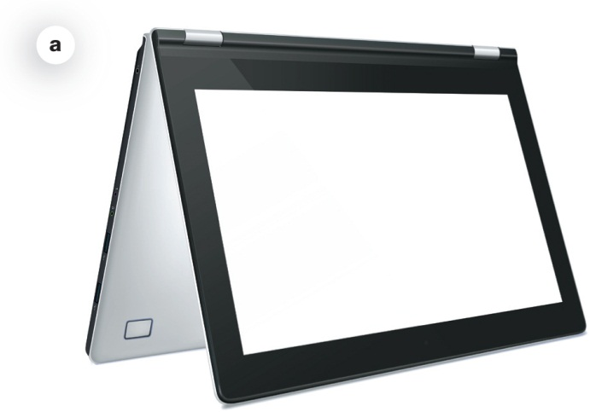
Understanding Your Computer: Types of Computers
Portable
Tablet computers
Laptop or notebook computers
Netbooks
Ultrabooks
Tablet (convertible) PCs
Notes:
8
There are two basic designs of computers: portable and stationary.
A tablet computer is a portable computer integrated into a flat touch-sensitive screen. It uses an onscreen virtual keyboard, but you can connect a separate keyboard via Bluetooth or wires.
A laptop or notebook computer is a portable computer that has a keyboard, monitor, and other devices integrated into a single compact case.
A netbook is a small, lightweight laptop computer that is generally 7 – 10 inches wide and has a longer battery life than a laptop.
An ultrabook is a full-featured but lightweight laptop computer designed to compete with the MacBook Air.
A tablet PC (or convertible PC) is similar to a laptop, but the monitor swivels and folds flat.

Slide 7
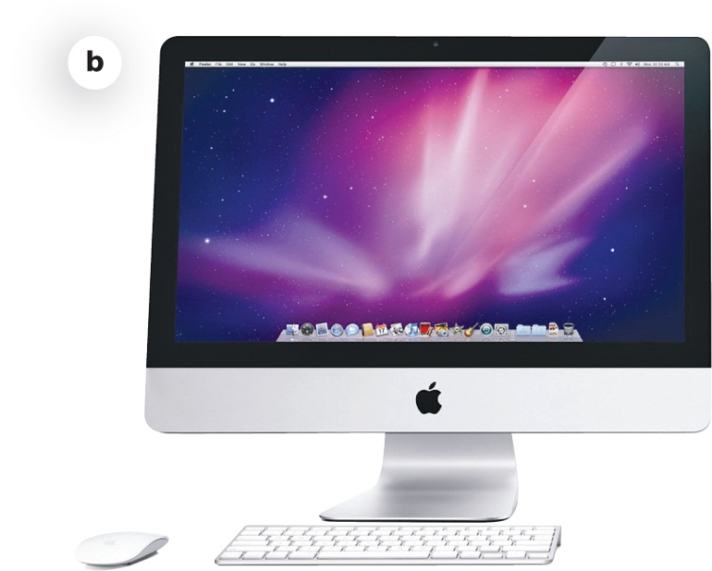
Understanding Your Computer: Types of Computers (cont.)
Stationary
Desktop computers
All-in-one computers
Notes:
8
A desktop computer is intended for use at a single location, so it is stationary.
Most desktop computers consist of a separate case or tower (called the system unit) that houses the main components of the computer plus peripheral devices such as a keyboard, mouse, and monitor.
An all-in-one computer, such as the Apple iMac or HP TouchSmart, eliminates the need for a separate tower because these computers house the computer’s processor and memory in the monitor. Many all-in-one models also incorporate touch-screen technology.

Slide 8
Understanding Your Computer: Types of Computers (cont.)
Mainframe
Many users simultaneously
Supercomputer
Complex calculations
Notes:
8
A mainframe is a large, expensive computer that supports many users simultaneously.
Mainframes are often used in businesses that manage large amounts of data where many people are working at the same time on similar operations.
Mainframes excel at executing many different computer programs at the same time.
A supercomputer is a specially designed computer that performs complex calculations rapidly.
Supercomputers are used when complex models requiring intensive mathematical calculations are needed.
Supercomputers are designed to execute a few programs as quickly as possible.

Slide 9
Understanding Your Computer: Types of Computers (cont.)
Smartphone
Embedded
Self-contained
E.g., car, electronic thermostat
Notes:
8
A smartphone does more than let you make and answer phone calls.
It also has productivity (application software), media player, and camera features, as well as Web connectivity.
A smartphone has a CPU, memory, and storage just like a laptop computer.
An embedded computer is a specially designed computer chip that resides in another device, such as your car or the electronic thermostat in your home.
Embedded computers are self-contained computer devices that have their own programming
Embedded computers typically don’t receive input from you or interact with other systems.

Slide 10
Understanding Your Computer: Bits and Bytes: The Language of Computers (cont.)
Hardware – any physical part of the computer that you can touch
Software – set of computer programs that enables the hardware to perform tasks.
Application software
System software
Operating system (OS)
Notes:
11
Computers use hardware and software to process data into information.
Hardware is any part of the computer you can touch.
Software is the set of computer programs that enables the hardware to perform tasks.
There are two categories of software: application software and system software.
Application software is the set of programs to help you carry out tasks such as writing a research paper.
System software is the set of programs that enables your computer’s hardware devices and application software to work together.
The most common type is the operating system (OS) - the program that controls how your computer system functions.

Slide 11
Hardware - Input Devices
Keyboard
Mouse
Touchscreen
Stylus
Camera
Microphone
Scanner
Notes:
12
An input device enables you to enter data (text, images, and sounds) and instructions (user responses and commands) into your computer.
A stylus is an input device that looks like a skinny pen, which you use to tap commands or draw on a screen.

Slide 12
Hardware - Output Devices
Send data out of the computer
Text
Pictures
Sounds
Video
Monitors
Printers
Speakers and earphones
Notes:
23
An output device lets you send processed data out of your computer in the form of text, pictures (graphics), sounds (audio), or video.
The most common output device is a monitor (sometimes referred to as a display screen), which displays text, graphics, and video as soft copies (copies you can see only on screen).
Another common output device is a printer, which creates hard copies (copies you can touch) of text and graphics.
Speakers and earphones are output devices for sound.

Slide 13
Output Devices: Monitors
Liquid crystal display (LCD)
Light-emitting diode (LED)
Notes:
23
The most common type of monitor is a liquid crystal display (LCD), also called a flat-panel monitor, which is light and energy-efficient.
Some newer monitors use light-emitting diode (LED) technology
LED is even more energy efficient than LCD, and has better color accuracy and thinner panels than LCD monitors.
CRT monitors are considered legacy technology, or computing devices that use techniques, parts, and methods that are no longer popular.

Slide 14
Output Devices: Monitors (cont.)
How LCD monitors work
Made up of coloured pixels
Two or more sheets of material
Liquid crystal solution
Crystals block or let light through
Notes:
25
Monitor screens are grids made up of millions of tiny dots called pixels.
Typically RED, BLUE, GREEN or CYAN (lt blue), MAGENTA (pink), YELLOW, BLACK
LCD monitors are made of two or more sheets of material filled with a liquid crystal solution.
A fluorescent panel at the back of the LCD monitor generates light waves.
When electric current passes through the liquid crystal solution, the crystals move around and either block the fluorescent light or let the light shine through.
This blocking or passing of light by the crystals causes images to form on the screen.

Slide 15
Output Devices: Monitors (cont.)
Quality of an LCD
Aspect ratio
Resolution
Contrast ratio
Viewing angle
Brightness
Response time
Notes:
26
The aspect ratio is the width-to-height proportion of a monitor.
The screen resolution is the clearness or sharpness of the image.
The contrast ratio is the measure in the difference in light intensity between the brightest white and the darkest black.
The viewing angle measures how far you can move to the side of the monitor before the image quality degrades to unacceptable levels.
Brightness is a measure of the greatest amount of light showing when the monitor is displaying pure white.
Response time is the time it takes for a pixel to change color.

Slide 16
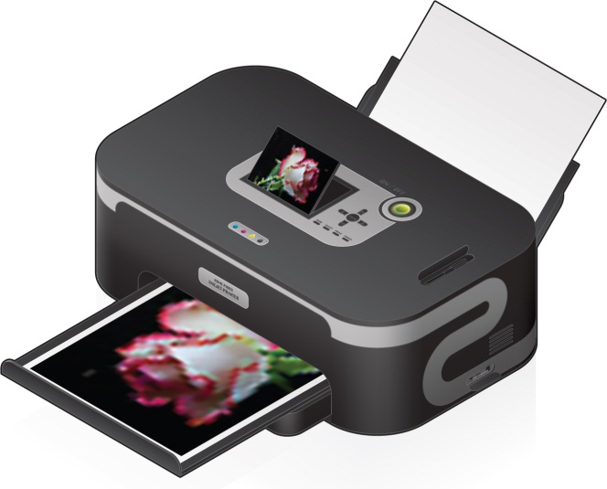
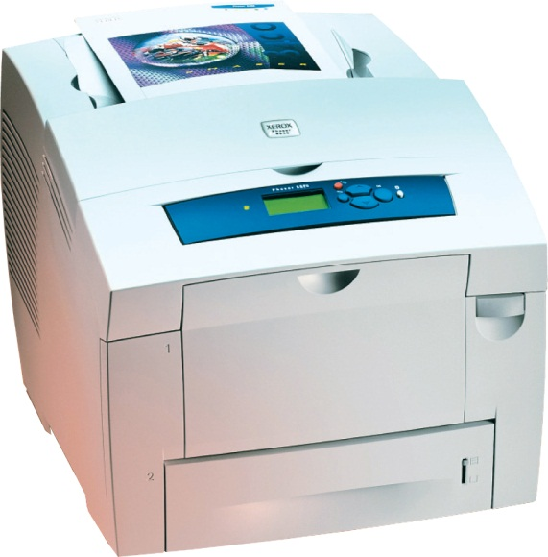
Output Devices: Printers (cont.)
Inkjet
Affordable
High-quality color
Quick and quiet
Laser
Faster printing speed
Higher quality printouts
More expensive
Notes:
30
Inkjet printers are popular because they are affordable and produce high-quality color printouts quickly and quietly.
Inkjet printers work by spraying tiny drops of ink onto paper and are great for printing black-and-white text as well as color images.
Laser printers use laser beams and static electricity to deliver toner (similar to ink) onto the correct areas of the page.
Heat fuses toner to the page, making the image permanent.
They have a faster printing speed than inkjet printers and produce higher quality printouts.

Slide 17
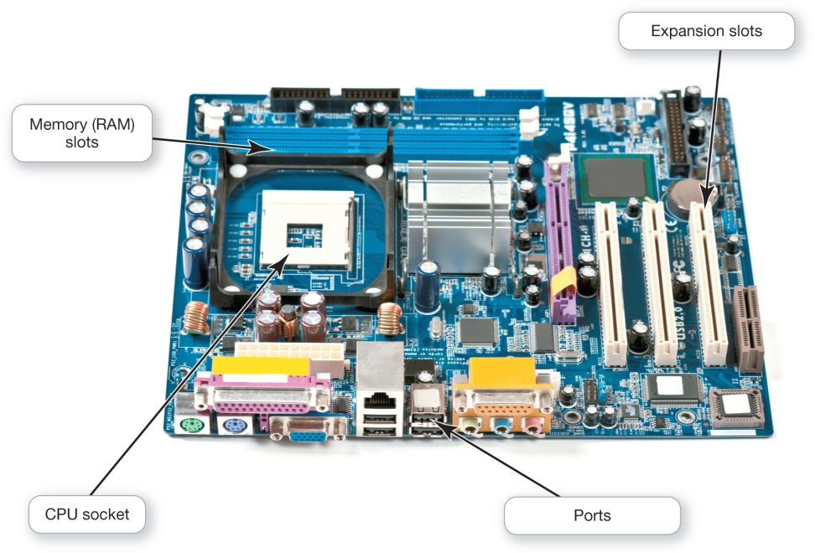
Processing and Memory on the Motherboard
Motherboard
CPU
ROM, RAM, and cache
Expansion cards
Network interface card (NIC)
Notes:
42
The motherboard is the main circuit board that contains the central electronic components of the computer, including the computer’s processor (CPU), its memory, and the many circuit boards that help the computer function.
On a desktop computer, the motherboard is located inside the system unit.
The motherboard includes slots for expansion cards (or adapter cards), which are circuit boards that provide additional functionality.
Typical expansion cards in the system unit are sound and video cards.
A sound card provides a connection for the speakers and microphone.
A video card provides a connection for the monitor.
A network interface card (NIC) enables a computer to connect with other computers or to a cable modem to facilitate a high-speed Internet connection.

Slide 18
Processing and Memory on the Motherboard
Notes:
42

Slide 19
Processing and Memory on the Motherboard: Processing
Central Processing Unit
CPU or processor
“Brains” of the computer
Controls all functions of the computer’s components
Processes all commands and instructions
Billions of tasks per second
Notes:
43
The central processing unit (CPU, or processor) is sometimes referred to as the “brains” of the computer because it:
controls all the functions performed by the computer’s other components, and
processes all the commands issued to it by software instructions.
Modern CPUs can perform as many as tens of billions of tasks per second without error, making them extremely powerful components.

Slide 20
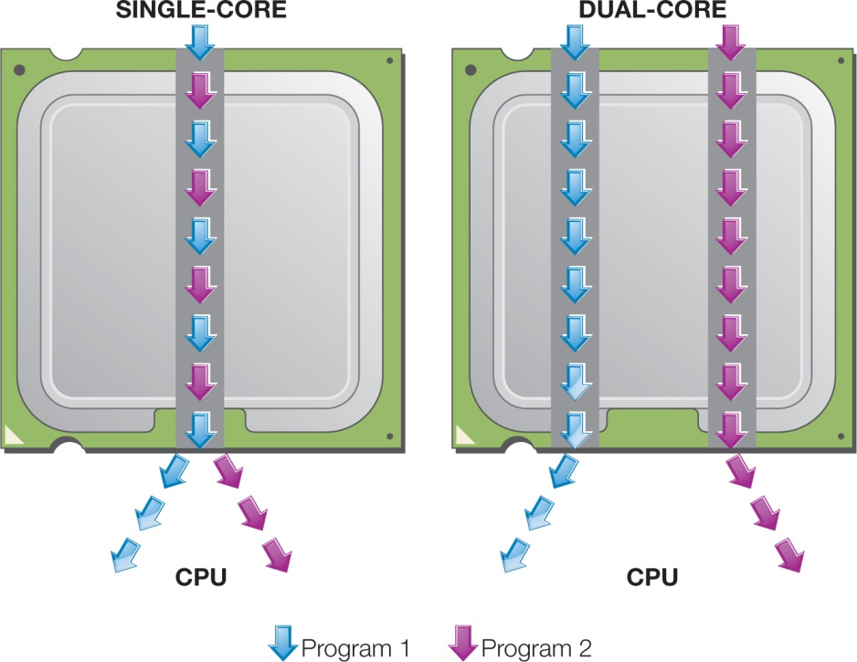
Processing and Memory on the Motherboard: Processing (cont.)
CPU Performance Measures
Processor speed measured in hertz (Hz)
Megahertz (MHz) or gigahertz (GHz)
Number of cores
Single
Dual
Quad
Eight
Notes:
43
Processor speed is measured in units of hertz (Hz). Hertz is a measurement of machine cycles per second.
Machine cycle also known as instruction cycle or fetch-decode-execute cycle.
Process by which a computer:
retrieves an instruction from its memory;
determines what actions the instructions require; and
carries out those actions.
Current systems run at speeds measured in gigahertz (GHz), or billions of machine cycles per second.
Therefore, a 3.8 GHz processor performs work at a rate of 3.8 billion machine cycles per second.
CPU performance is also affected by the number of cores, or processing paths, the processor has.
Processors have been designed that have two, four, and even eight cores.

Slide 21
Processing and Memory on the Motherboard: Memory
RAM - Random Access Memory
Stores instructions and data
Series of several memory cards or modules
Temporary (volatile) storage
Notes:
Random access memory (RAM) is the place in a computer where the programs and data the computer is currently using are stored.
RAM is much faster to read from and write to than the hard drive and other forms of storage.
Because the entire contents of RAM are erased when you turn off the computer, RAM is the temporary or volatile storage location.

Slide 22
Processing and Memory on the Motherboard: Memory (cont.)
ROM - Read-Only Memory
Stores startup instructions
Permanent (nonvolatile) storage
Notes:
Read-only memory (ROM) holds all the instructions the computer needs to start up when it is powered on.
The instructions stored in ROM are permanent, making ROM a nonvolatile storage location
i.e., the data isn’t erased when the power is turned off.

Slide 23
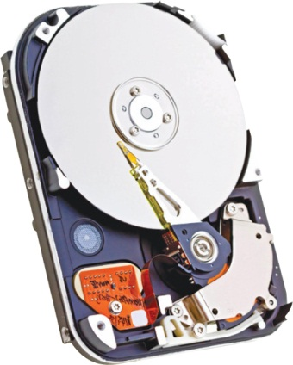
Storing Data and Information: Hard Drives
Primary device for permanent storage
Stores programs and data
Internal or external (portable)
Solid State Drive (SSD)
Notes:
36
The hard disk drive (HDD), or hard drive is your computer’s primary device for permanent storage of software and documents.
The hard drive is a nonvolatile storage device.
An internal hard drive resides within the system unit and usually holds all permanently stored programs and data.
External hard drives offer similar storage capacities but reside outside the system and connect via a USB or FireWire port.
The most common type of hard drive has moveable parts—spinning platters, a moving arm with a read/write head—that can fail and lead to disk failure.
The solid-state drive (SSD) has become a more feasible option for storage. SSDs have no moving parts so they’re:
more efficient;
run with no noise;
emit little heat;
require little power
less likely to fail.

Slide 24
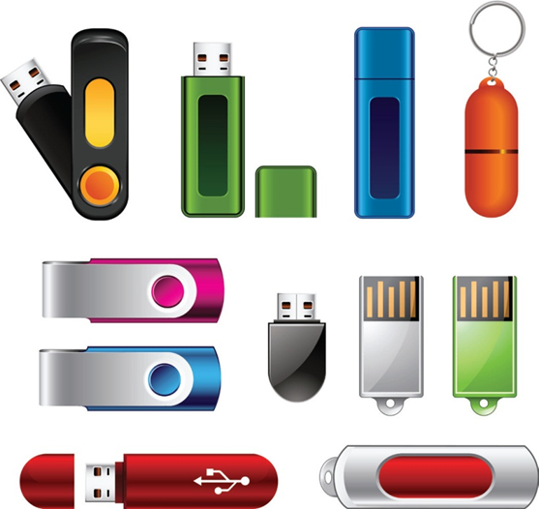
Storing Data and Information: Storage
Flash Drive
Flash Memory
Optical Storage
Compact discs (CDs)
Digital video discs (DVDs)
Blu-ray discs (BDs)
Cloud Storage
Notes:
A flash drive (sometimes referred to as a jump drive, USB drive, or thumb drive) uses solid-state flash memory, storing information on an internal memory chip.
When you plug a flash drive into your computer's USB port, it appears in the operating system as another disk drive. You can write or read data from it as you would a hard drive.
Flash drives can have significant storage capacity, currently as much as 256 GB.
A flash memory card, such as an SD card, is another convenient means of portable storage.
Like the flash drive, memory cards use solid-state flash memory.
Flash memory cards let you transfer digital data between your computer and devices such as digital cameras, smartphones, video cameras, and printers.
CONTINUED – next page
Most desktop and laptop computers include at least one optical drive that can read from and maybe even write to CDs, DVDs, or Blu-ray discs.
Compact discs (CDs) were initially created to store audio files (700 MB).
Digital video discs (DVDs) are the same size and shape as CDs but can hold up to 14 times more data.
Blu-ray discs (BDs) can hold as much as 50 GB of data.
Cloud storage refers to using a service that keeps your files on the Internet (in the “cloud”) rather than on a local device.
Cloud storage alternatives include Dropbox, Apple iCloud, Microsoft OneDrive, and Google Drive.

Slide 25
Connecting Peripherals to the Computer
Port
Location where peripheral devices are attached to computer’s motherboard
Universal Serial Bus (USB)
Most common port, providing high-speed connectivity to wide range of devices.
Notes:
We have discussed peripheral devices that input, store, and output data and information.
E.g., keyboard, mouse, monitor, speakers, external hard drive, etc.
A port is a place through which a peripheral device attaches to the computer so that data can be exchanged between it and the operating system.
Although peripherals may connect to devices wirelessly, ports are still often used for connections.
A universal serial bus (USB) port is the port type most commonly used to connect input and output devices to the computer. This is mainly because of the ready availability of USB-compatible peripherals.
USB ports can connect a wide variety of peripherals, including keyboards, printers, mice, smartphones, external hard drives, flash drives, and digital cameras, to computing devices.
The current USB 3.0 standard provides transfer speeds of 4.8 Gbps and charges devices faster than its predecessor.

Slide 26
Connecting Peripherals to the Computer: Connectivity and Multimedia Ports
Connectivity ports (Ethernet, modem)
Audio ports (headphones, speakers, mics)
Video ports (monitors, multi-media, HDMI)
Expansion cards (to add new ports)
Expansion hubs (multi devices to one port)
Notes:
A connectivity port can give you access to networks and the Internet.
To find a connectivity port, look for a port resembling a phone jack but slightly larger. This port is called an Ethernet port.
Other ports on the back and sides of the computer include the audio and video ports.
Audio ports are where you connect headphones, microphones, and speakers to the computer.
A video port is needed to attach a monitor to a desktop computer or a second, larger display to a laptop computer.
HDMI ports are now the most common video port on computing devices.

Slide 27
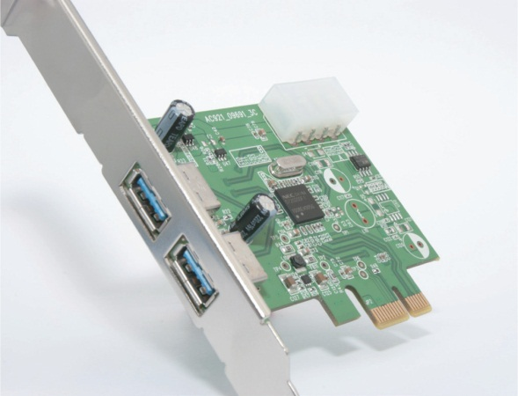
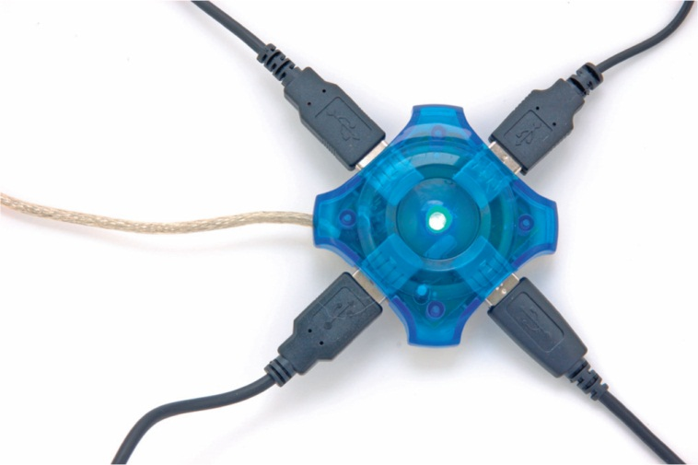
Connecting Peripherals to the Computer: Adding Ports: Expansion Cards and Hubs
Expansion cards
Expansion hubs
Notes:
If you’re looking to add the newest ports to an older computer or to expand the number of ports on it, you can install special expansion cards into an open expansion slot on the motherboard to provide additional ports.
Another alternative is adding an expansion hub, a device that connects to one port, such as a USB port, to provide additional new ports.
It works like the multiplug extension cords used with electrical appliances.

Slide 28
Power Controls
Power supply
Turning off your computer
Stress on computer vs. wasting electricity
Power-management settings
Windows power-management options
Notes:
35
The power supply, which is housed inside the system unit, transforms the wall voltage to the voltages required by computer chips.
Some people say you should always leave your computer on because turning it off and on causes stress on the computer.
Others say you should shut down because it is not environmentally friendly and wastes electricity.
Modern operating systems include power-management settings that allow power-hungry components to shut down after a short idle period.
With the power-management options of Windows, computers only need to be shut down to be repaired, moved or to install hardware.

Slide 29
System Software
BUS 140: Business Information Technology

Slide 30
Understanding System Software: Operating System Fundamentals
Application (productivity) software – used to carry out everyday tasks
System software – the set of programs that help run the computer
Operating system (OS)
Utility programs
Notes:
Computers uses two basic types of software: application and system software.
Application software is the software you use to do everyday tasks.
System software helps run the computer and coordinates instructions between application software and the computer’s hardware devices.
The operating system (OS) is a group of programs that controls how your computer system functions. It does the following:
Manages the computer’s hardware and peripheral devices.
Provides a consistent means for application software to work with the central processing unit (CPU)
Is responsible for the management, scheduling, and coordination of tasks
A utility program is a small program that performs many general housekeeping tasks for your computer.
E.g., anti-virus software, backup software, file management software

Slide 31
Understanding System Software: Operating System Fundamentals (cont.)
Operating System Fundamentals
Multitasking
Networking capabilities
Notes:
Modern operating systems allow a single user to multitask—to perform more than one process at a time.
E.g., printing, streaming video, receiving emails
Operating systems such as Windows and OS X provide networking capabilities as well

Slide 32
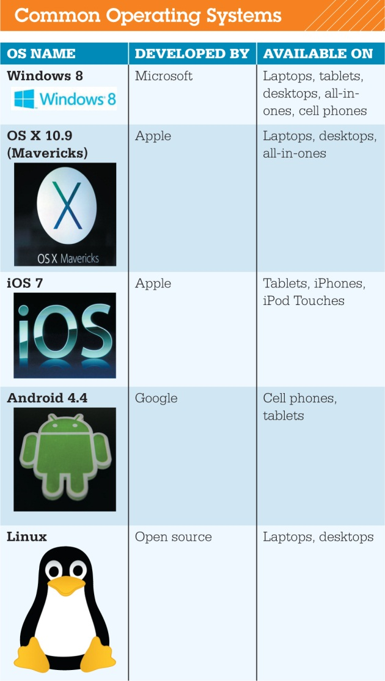
Understanding System Software: Operating System Fundamentals (cont.)
Categorized by device
Mainframes
Network computers
Personal computers
Mobile devices
Gaming systems
Robots
Notes:
Every computer has an OS. Even smartphones, game consoles, cars, and some appliances have operating systems.
The role of the OS is critical; the computer can’t operate without it.
Different devices need specific operating systems designed to take advantage of their unique characteristics.

Slide 33
Understanding System Software: Operating Systems Fundamentals (cont.)
Operating Systems
Unix
Linux
Mac OS X
Windows
Application software is OS-dependent
Notes:
Unix
Developed by AT&T in the 1970s as a multi-tasking, multi-user OS.
Unix was the first “portable” OS that could be used across multiple platforms.
Many clones of Unix over the years, including Linux
Linux
Linux is an open source OS designed for use on personal computers and as a network OS.
Open source software is freely available for anyone to use or modify.
Linux has a reputation as a stable OS.
Android, the tablet and phone OS, is Linux-based.
Mac OS X
Mac OS was the first commercially available OS with a graphical user interface (GUI) -- user-friendly point-and-click technology.
OS X uses the same desktop metaphors as Windows, including icons for folders and a Trash Can (similar to a Recycle Bin) for deleted documents.
Mac OS X is based on the UNIX operating system, which is exceptionally stable and reliable.
Microsoft Windows
Installed in all Camosun Business labs
Windows incorporates a user-friendly visual interface similar to the one first introduced by Apple.
Latest versions of Windows are optimized for touchscreens
Top 3 OS today are Windows, MacOS, Linux.
Computers usually come with an OS already installed. With some PCs, you can specify which OS you’d like installed when you order your device.
Note that most application software is OS-dependent. You need to make sure you get the correct version for your OS.

Slide 34
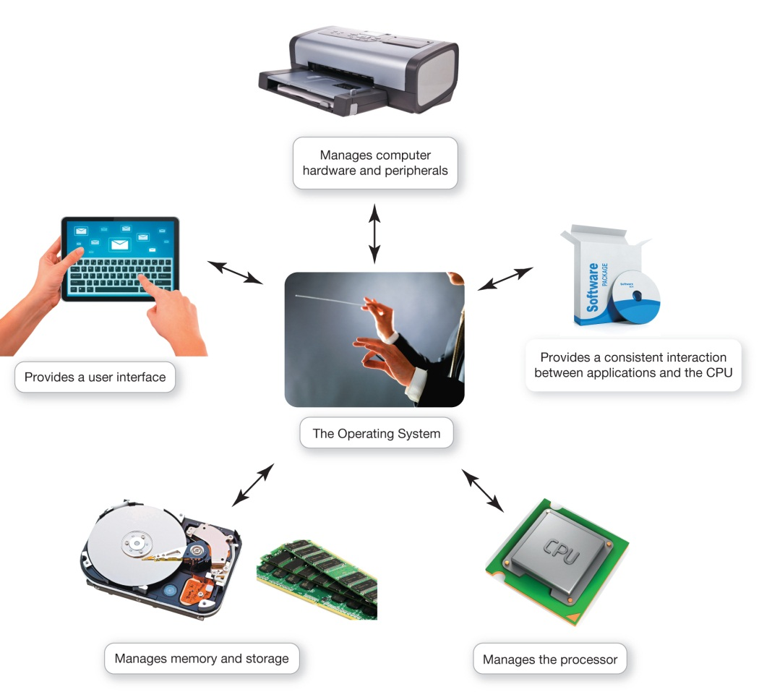
What the Operating System Does
OS: Coordinates and directs the flow of data and information through the computer system
Notes:
The OS coordinates and directs the flow of data and information through the computer system, including:
Manages hardware & peripherals
Manages interaction between software and CPU
Manages the CPU
Manages memory and data storage
Provides a user interface
OS assigns a slice of time for each activity, then manages slices to ensure that multiple tasks can be performed concurrently.

Slide 35
What the Operating System Does: The User Interface
User Interface enables user to interact with the computer
Types of interfaces:
Command-driven interface (e.g., MS-DOS)
Menu-driven interface
Graphical user interface (GUI)
Notes:
The OS provides a user interface that lets you interact with the computer.
The first computers used Microsoft Disk Operating System (MS-DOS), which had a command-driven interface.
A command-driven interface is one in which you enter commands to communicate with the computer system.
The command-driven interface was later improved by incorporating a menu-driven interface, in which you choose commands from menus.
Menu-driven interfaces eliminated the need for users to know every command.
Current personal computer operating systems such as Microsoft Windows and Mac OS use a graphical user interface, or GUI (pronounced “gooey”). Unlike command- and menu-driven interfaces, GUIs display graphics and use the point-and-click technology of the mouse and cursor, making them much more user-friendly.

Slide 36
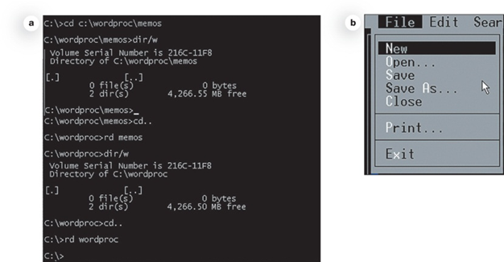
What the Operating System Does: The User Interface
Command-driven interface
Menu-driven interface

Slide 37
What the Operating System Does: Memory and Storage Management
OS uses RAM as a temporary storage for instructions and data
OS is responsible for coordinating space allocation in RAM
OS clears items from RAM when no longer needed
Notes:
As the OS coordinates the activities of the processor, it uses RAM as a temporary storage area for instructions and data the processor needs.
The processor accesses these instructions and data from RAM when it is ready to process them.
The OS is responsible for coordinating the space allocations in RAM to ensure that there is enough space for all of the pending instructions and data.
OS then clears the items from RAM when the processor no longer needs them.

Slide 38
What the Operating System Does: Virtual Memory
Virtual Memory – when RAM is full, some instructions and data are transferred to the hard drive using a swap file.
If data or instructions are needed later, the OS swaps them back. This process is called paging.
Increase RAM to avoid using virtual memory.
Notes:
RAM has limited capacity. When there isn’t enough room for the OS, it borrows room from the hard drive (virtual memory).
When more RAM space is needed, the OS swaps out data or instructions that have not been recently used and moves them to a temporary storage area called the swap file (or page file).
If the data or instructions are needed later, the OS swaps them back. This process is known as paging.
The solution to this problem is to increase the amount of RAM.

Slide 39
The Boot Process: Starting the Computer
The boot process loads the operating system into RAM
Cold boot – powering computer on from a completely turned-off state
Warm boot – computer is restarted by OS without being turned off first
Notes:
All data and instructions (including the OS) are stored in RAM while your computer is on.
When you turn off your computer, RAM is wiped clean of all its data.
How does the computer know what to do when you turn it on if there is nothing in RAM?
It runs through a special boot process (or start-up process) to load the OS into RAM.
The term boot, from bootstrap loader (a small program used to start a larger program), alludes to the straps of leather, called bootstraps, that people used to use to help them pull on their boots.
Powering on your computer from a completely turned-off state, such as when you start your computer in the morning, is called a cold boot.
Warm boot (restarting computer from “on” mode) often required when installing new software.

Slide 40
The Boot Process: Starting the Computer: Step 1: Activating BIOS
CPU activates the Basic Input/Output System (BIOS)
BIOS manages data exchange between OS and input/output devices
BIOS stored in ROM
Notes:
In the first step of the boot process, the CPU activates the basic input/output system (BIOS).
BIOS is a program that manages the exchange of data between the OS and all the input and output devices attached to the system.
BIOS is also responsible for loading the OS into RAM from its permanent location on the hard drive.
BIOS itself is stored on a read-only memory (ROM) chip on the motherboard.
Unlike data stored in RAM, data stored in ROM is permanent and is not erased when the power is turned off.

Slide 41
The Boot Process: Starting the Computer: Step 2: Performing the Power-On Self-Test
BIOS launches the Power On Self Test (POST)
POST ensures essential peripherals are attached and functional (e.g., keyboard)
Notes:
The first job BIOS performs is to ensure that essential peripheral devices are attached and operational—a process called the power-on self-test or POST.
The BIOS compares the results of the POST with the various hardware configurations permanently stored in CMOS (pronounced “see-moss”).
CMOS, which stands for complementary metal-oxide semiconductor, is a special kind of memory that uses almost no power.
CMOS contains information about the system’s memory, types of disk drives, and other essential input and output hardware components.
If the results of the POST compare favorably with the hardware configurations stored in CMOS, the boot process continues.

Slide 42
The Boot Process: Starting the Computer: Step 3: Loading the OS
System files (OS) located and loaded into RAM
Kernal (OS supervisor program) loaded into RAM.
Responsible for managing the processor and all system components
Notes:
Next, BIOS goes through a preconfigured list of devices in its search for the drive that contains the system files, the main files of the OS. When it is located, the OS loads into RAM.
Once the system files are loaded into RAM, the kernel (or supervisor program) is loaded. The kernel is an essential component of the OS, responsible for managing the processor and all other components of the computer system.
Other less critical parts of the OS stay on the hard drive and are copied over as-needed. Once the kernel is loaded, the OS takes over control.

Slide 43
The Boot Process: Starting the Computer: Step 4: Checking Further Configurations and Customizations
OS checks registry for configuration of other system components
Mouse speed, keyboard language
Screen resolution
Order of program loading
Authentication (login)
Notes:
Finally, the OS checks the registry for the configuration of other system components.
E.g., mouse speed, keyboard language, screen resolution, etc.
The registry contains configurations (settings) used by the OS and by other applications.
The verification of your login name and password is called authentication.
The authentication process blocks unauthorized users from entering the system. All large networked environments, like your college, require user authentication for access.

Slide 44
What the Operating System Does: Processor Management
CPU performs several tasks at once
OS arranges for execution of activities by
assigning time to each activity
switching among processes
Appears everything happens seamlessly
Notes:
When you use your computer, you’re usually asking the processor to perform several tasks at once, such as:
printing a Word document
chatting or emailing friends
watching a movie.
CPU is powerful, but needs the OS to arrange the execution of these activities in a systematic way.
The OS assigns a slice of its time to each activity. It then switches among different processes millions of times a second to make it appear that everything is happening seamlessly.
Otherwise, you wouldn’t be able to watch a movie and print at the same time without experiencing delays.

Slide 45
What the Operating System Does: Processor Management (cont.)
Interrupt
Interrupt handler
Preemptive multitasking
Notes:
Although it looks as though all the devices are working simultaneously, the OS actually switches back and forth among processes.
Assume you’re typing and want to print.
When you tell your computer to print your document, the printer generates an interrupt
Interrupt that tells the OS that it’s in need of immediate attention.
Every device has its own type of interrupt, which is associated with an interrupt handler
Interrupt handler is a special numerical code that helps to prioritize the requests.
These requests are placed in the interrupt table in the computer’s RAM.
The OS processes tasks in order of priority. This is called preemptive multitasking.

Slide 46
What the Operating System Does: Processor Management (cont.)
OS coordinates peripheral device activity
If processor received print request:
Checks with OS to see if printer is in use
If yes, request is stored in buffer
Waits until spooler indicates printer ready
If multiple print jobs are waiting, request is placed in queue
Notes:
The OS also coordinates multiple activities for peripheral devices such as printers.
When the processor receives a print request, it first checks with the OS to ensure that the printer is not already in use.
If it is, the OS puts the request in a temporary storage area called the buffer.
The request waits until the spooler, a program that helps coordinate all print jobs being sent to the printer, indicates the printer is available.
If more than one job is waiting, a queue is formed so that the printer can process the requests in order.

Slide 47
Organizing Your Computer: File Management
OS organizes files in a hierarchical directory structure.
All files must be uniquely named, unless stored in different locations.
No two files stored in same folder can share same file name and file extension.
Notes:
Each OS has its own file naming rules.
It is important to name your files so they are easily identifiable. File names can have as many as 255 characters. A file name such as “BIO Research Paper Draft.docx” makes it very clear what the file contains.
All files must be uniquely identified, unless they are saved in different folders or locations.
Files might share the same file name (“bioreport.docx” and “bioreport.xlsx”) or the same extension (“bioreport.xlsx” and “budget.xlsx”)
no two files stored on the same device and folder can share both the same file name and extension.

Slide 48
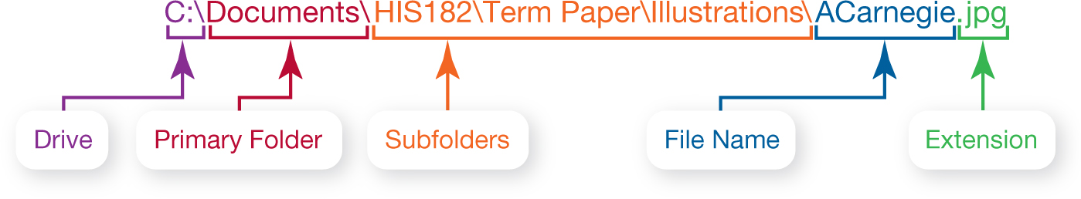
Organizing Your Computer: File Management (cont.)
Notes:
If you were saving a picture of Andrew Carnegie, the file path might be C:\Documents\HIS182\Term Paper\Illustrations\ACarnegie.jpg.
“C:” is the drive on which the file is stored, and Documents is the file’s primary folder.
“HIS182,” “Term Paper,” and “Illustrations” are successive subfolders within the Documents main folder.
Last comes the file name, “ACarnegie,” separated from the file extension (in this case, “jpg”) by a period.
The backslash characters (\), used by Windows, are referred to as path separators.
OS X files use a colon (:), and UNIX and Linux files use the forward slash (/) as the path separator.

Slide 49
Utility Programs
Utility programs are small programs that perform specific functions
Incorporated into operating system
Firewall and file-compression utilities
Standalone utility programs
Antivirus and security programs
Freeware
Notes:
Utility programs are small applications that perform special functions.
Utility programs come in three flavors:
Those that are included with the OS (such as Task Manager, Disk Defragmenter)
Those sold as standalone programs (such as antivirus software)
Those offered as freeware (such as anti-malware software like Ad-Aware from Lavasoft)
The basic utilities designed to manage and tune the computer hardware are incorporated into the operating system.
The stand-alone utility programs typically offer more features or an easier user interface for backup, security, diagnostic, or recovery functions.
For some Windows programs, like Task Manager and Resource Monitor, no good standalone alternative exists.

